Slide 1
PROCEDURES
IN SQL WE CAN ALSO DEFINE PROCEDURES.
THE FUNCTIONS, AS WE HAVE SEEN THEM, ARE OBLIGED TO RETURN A VALUE, AND ONLY ONE
SOMETIMES WE WANT TO PERFORM FUNCTIONS THAT DO NOT RETURN ANY VALUE, OR THAT RETURN MORE THAN ONE
IN THOSE CASES WE WILL USE THE PROCEDURES

Slide 2
PROCEDURES
THE SYNTAX OF THE PROCEDURES IS
CREATE PROCEDURE nom (paràmetres...)
Next we need to specify the parameters that we will pass to the procedure at the time of calling it. They are optional, and can be of three types: IN, OUT, or INOUT
Also, as in the case of functions, you must specify what type of variable it is in terms of its content (INT, FLOAT, VARCHAR, etc.)

Slide 3
PROCEDURES
CREATE PROCEDURE nom (IN x INT)
IN
is an input parameter, which is passed by value. This means that we do not have to modify it within the procedure, we simply use its value to do some calculation or other operations.

Slide 4
PROCEDURES
EXAMPLE OF IN PARAMETER
WE ARE GOING TO DO A PROCEDURE THAT INCREASES THE PRICE OF A HOTEL ROOM BY 5%
THE HOTEL WE WANT TO MODIFY IS PASSED AS AN ENTRY PARAMETER
CREATE PROCEDURE puja5 (IN hotel INT)
BEGIN
UPDATE habitacio SET preu=preu*1.05
WHERE idHotel=hotel;
END;
WE INCREASE THE PRICE OF THE ROOMS OF THE INDICATED HOTEL

Slide 5
PROCEDURES
CREATE PROCEDURE nom (OUT x INT)
OUT
is an output parameter, which is also passed by value
It actually works like the RETURN of a function, only the variable is already declared and we don't need to make a DECLARE

Slide 6
PROCEDURES
EXAMPLE OF OUT PARAMETER
WE WILL DO A PROCEDURE THAT COUNTS HOW MANY HOTELS THERE ARE IN TOTAL
The result to return is passed as the OUT parameter
CREATE PROCEDURE comptar (OUT total INT)
BEGIN
SELECT COUNT(*) INTO total FROM hotels;
END;
IS NOT NECESSARI TO DO RETURN

Slide 7
PROCEDURES
A PROCEDURE MAY HAVE MANY IN PARAMETERS AND MANY OUT PARAMETERS
LET'S DO A PROCEDURE THAT COUNTES HOW MANY ROOMS A HOTEL HAS
LET'S PASS THE TOTAL AS OUT PARAMETER
WE PASS THE HOTEL AS A IN PARAMETER
CREATE PROCEDURE comptahab (IN hotel INT, OUT total INT)
BEGIN
SELECT COUNT(*) INTO total FROM habitacio
WHERE idHotel=hotel;
END;

Slide 8
PROCEDURES
CREATE PROCEDURE nom (paràmetres...)
INOUT
is an output parameter that is passed by reference
This means that the variable must exist before calling the procedure, it can be modified within it, and the changes are maintained when exiting the procedure

Slide 9
PROCEDURES
EXAMPLE OF INOUT PARAMETER
WE DO A PROCEDURE TO WHICH WE PASS A NUMBER AND MULTIPLY IT FOR ITSELF
CREATE PROCEDURE eleva (INOUT num INT)
BEGIN
SET num = num * num;
END;

Slide 10
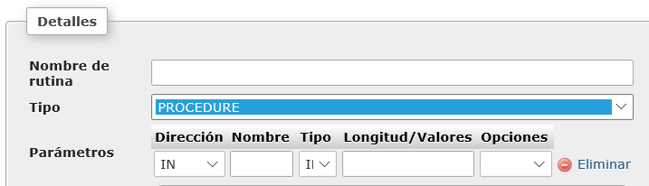
PROCEDURES
PROCEDURES CAN ALSO BE DONE FROM THE ROUTINE ASSISTANT
We have to choose PROCEDURE

Slide 11
PROCEDURES
SQL AVANÇAT: PROCEDIMENTS
THE PROCEDURES ARE CALLED WITH THE CALL OPERATOR
IF THEY HAVE VARIABLE PARAMETERS, THEY MUST BE DECLARED BEFORE CALLING THE PROCEDURE
TO SEE THE RESULT WE MUST SHOW THE VARIABLES THAT RETURN (WITH OUT OR WITH INOUT) USING A SELECT
VARIABLES FROM THE COMMAND LINE OR FROM THE SQL SCREEN ARE DECLARED BY PUTTING IN FRONT OF A SYMBOL @

Slide 12
PROCEDURES
THE PROCEDURES ARE CALLED WITH THE CALL OPERATOR
VARIABLES FROM THE COMMAND LINE OR FROM THE SQL SCREEN ARE DECLARED BY PUTTING IN FRONT OF A SYMBOL @
IF THEY HAVE VARIABLE PARAMETERS, THEY MUST BE DECLARED BEFORE CALLING THE PROCEDURE
SET @x=5;
CALL eleva(@x);
SELECT @x;
TO SEE THE RESULT WE MUST SHOW THE VARIABLES THAT RETURN (WITH OUT OR WITH INOUT) USING A SELECT

Slide 13
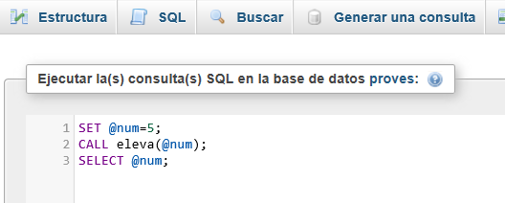

PROCEDURES
WE CAN CALL THE PROCEDURE FROM THE COMMAND LINE OR FROM THE SQL WINDOW

Slide 14
PROCEDURES
EXAMPLE: WE ARE GOING TO DO A PROCEDURE THAT WE PASS A TRADE AND GIVE US THE HIGHEST AND LOWEST SALARY OF THAT TRADE
CREATE PROCEDURE sousOfici
(OUT menor INT, OUT major INT, IN ofici VARCHAR(20))
BEGIN
SELECT MAX(souEmp) INTO major FROM empleat WHERE ofiEmp=ofici;
SELECT MIN(souEmp) INTO menor FROM empleat WHERE ofiEmp=ofici;
END

Slide 15
PROCEDURES
TO EXECUTE THE PROCEDURE
SET @ofici="Conserge";
call sousOfici(@menor, @major, @ofici);
SELECT @ofici AS "Ofici",
@menor AS "Més baixet",
@major AS "Més alt";

Slide 16
PROCEDURE
EXAMPLE: A PROCEDURE TO WHICH WE PASS THE STUDENT ID, THE MODULE ID AND A GRADE, AND WHICH PUTS THAT GRADE TO THE STUDENT IN THAT MODULE
CREATE PROCEDURE canviaNota
(IN notaNova INT, IN modul INT, IN alumne INT)
BEGIN
UPDATE matricula
SET notaMatricula = notaNova
WHERE idModul=modul AND idAlumne=alumne;
END

Slide 17
PROCEDURES
TO EXECUTE THE PROCEDURE
SET @alumne=1;
SET @modul=3;
SET @nota=8;
call canviaNota(@nota, @modul, @alumne);
IN THIS CASE THE PROCEDURE ONLY CHANGES DATA IN THE TABLES, IT DOESN'T RETURN ANYTHING AND THEREFORE THERE IS NOTHING TO SHOW WHEN THE PROCEDURE ENDS

Slide 18
PROCEDURES
EXERCISES
MAKE A PROCEDURE TO WHICH WE PASS A HOTEL AND RETURN WHICH IS THE MOST EXPENSIVE ROOM
MODIFY THE PREVIOUS PROCEDURE TO MAKE IT MOST EXPENSIVE AND ALSO CHEAPEST
MAKE A PROCEDURE TO WHICH WE PASS A TRADE AND GIVE US BACK THE NAME OF THE WORKER WHO MAKES THE MOST MONEY FROM THAT TRADE

